Slide 1
OMR Homes
AI-Powered Real Estate Insights

Slide 2
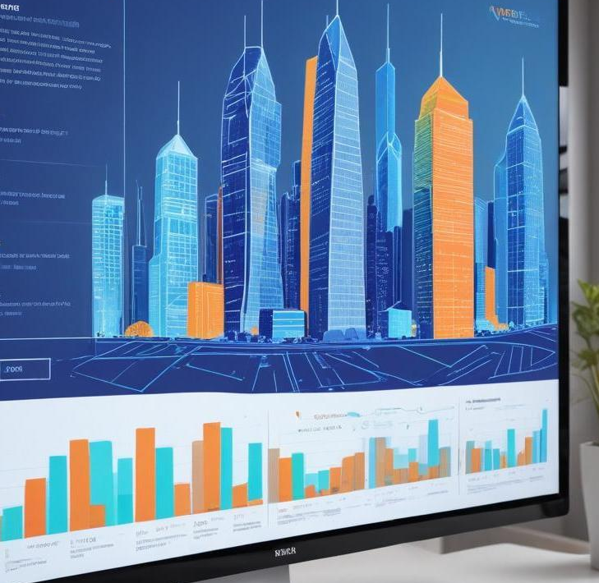
Problem Statement
Finding a house in today's digital world is a time-consuming and frustrating process, as property listings are scattered across multiple websites, each with different formats, pricing models, and filtering options. A buyer searching for a 2 BHK flat in a prime location like OMR must manually visit various developer websites, compare prices, check amenities, and verify the credibility of listings. This fragmented approach leads to inconsistencies in data, making it difficult to identify the best-value deals. Additionally, virtual apartment tours, which could help in decision-making, are often hosted on different platforms or buried deep within websites, requiring extra effort to access. The lack of a centralized platform for property comparison forces buyers to spend significant time and effort on research, delaying their decision-making process and increasing the risk of missing out on great deals.

Slide 3
SOLUTION
To solve the challenge of fragmented property listings and scattered virtual tours, we developed an AI-powered interactive website that simplifies the house-hunting process for buyers looking for 2 BHK flats in OMR. The platform uses web crawling to aggregate real-time property listings from reputed developers like Shobha and Prestige, ensuring buyers get the latest deals in one place.
The website features a smart comparison engine that ranks properties based on price per sq. ft., amenities, location advantages, and developer reputation, helping buyers make informed decisions quickly. To enhance user experience, we integrated AI-driven recommendations, which personalize suggestions based on the buyer’s budget, preferences, and search history.
Additionally, the platform adopts a visual-first approach by displaying listings with interactive maps, immersive 3D virtual tours, and video walkthroughs of apartments. A built-in AI chatbot assistant guides users through the search process, answering queries, suggesting properties, and even providing insights on market trends and price predictions.
To make the buying process seamless, the website also includes a mortgage calculator, real-time chat with property agents, and a deal scoring system to highlight the best-value options. By integrating AI and automation, our platform eliminates the need for manual comparisons, reduces search time, and enhances the overall property-buying experience.

Slide 4
AI Web Crawling
01
Smart Comparison Engine
02
03
AI Assistant
Graphical Representation of Price Trends
04
05
Legal Assistant
06
Neighbourhood Details

Slide 5
07
Smart Value Analysis
08
360 Virtual Tour
09
Interactive Map Property
10
Sustainability

Slide 6
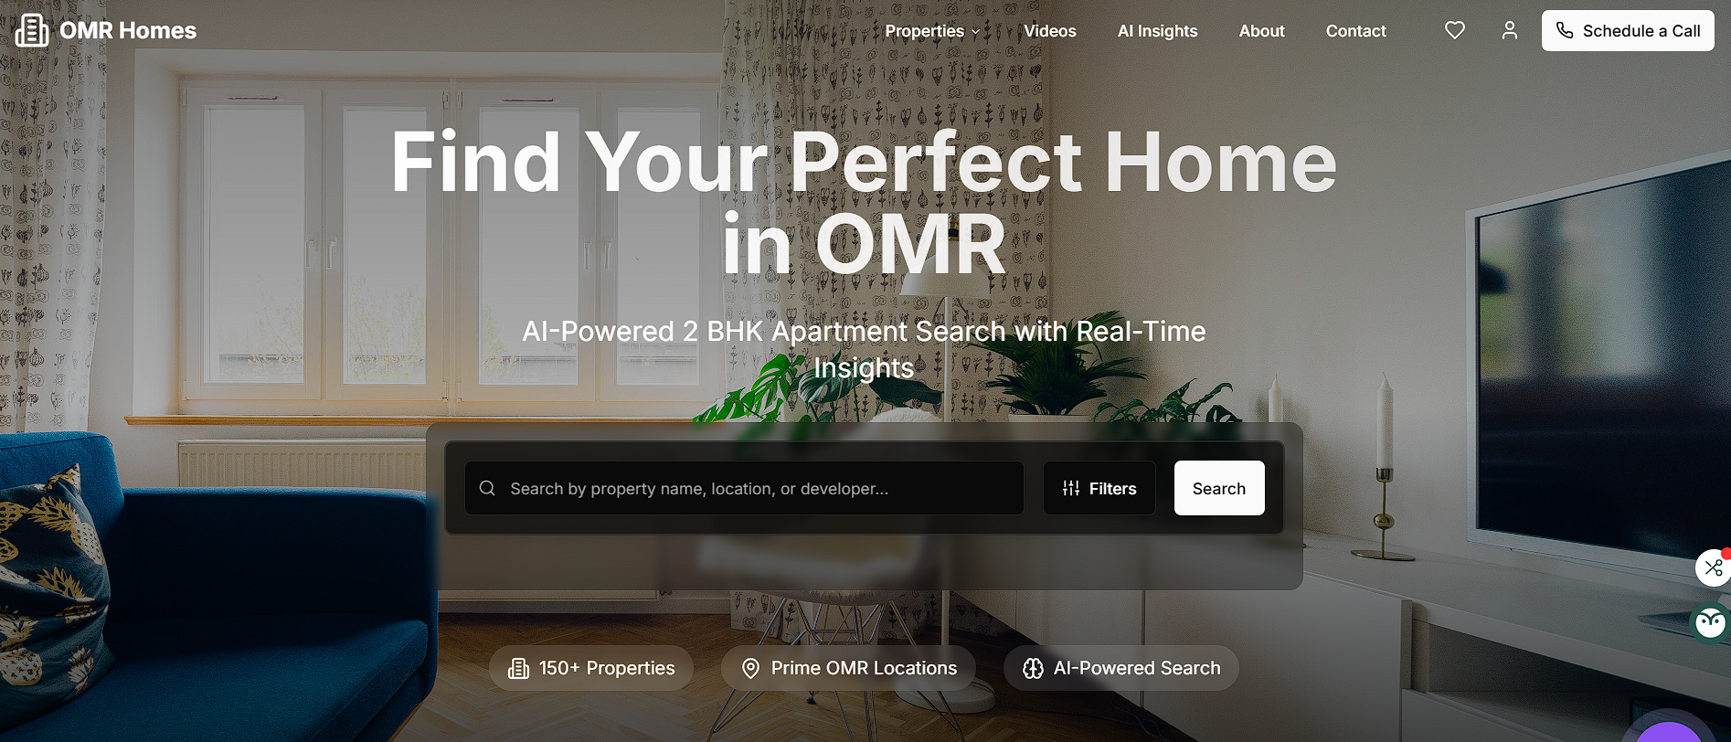
01

Slide 7
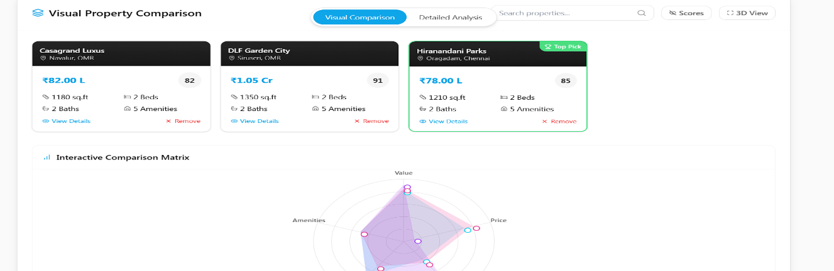
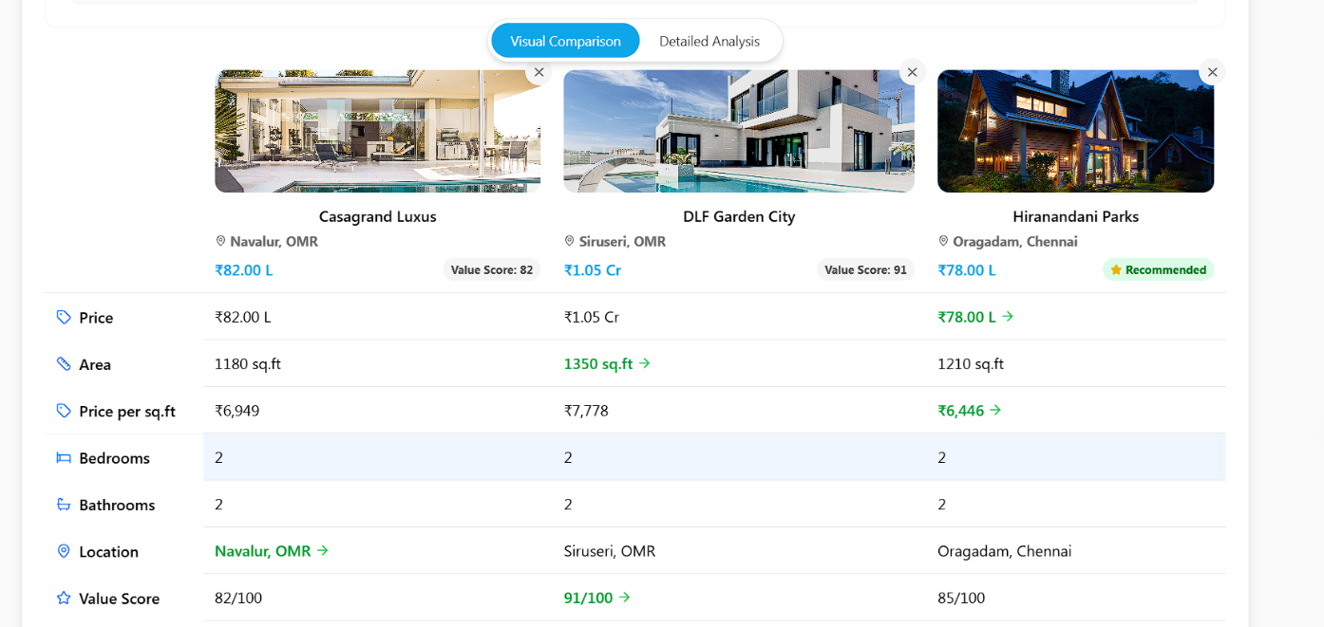
02
Once the listings are aggregated, the AI will compare prices to identify the best deals. This comparison will consider factors such as price per square foot, promotional offers, and additional benefits such as financing options and amenities, ensuring users find the most value for their investment.

Slide 8
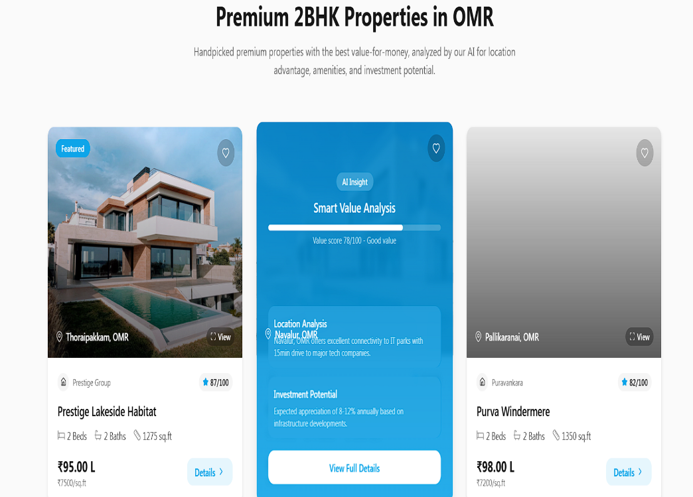
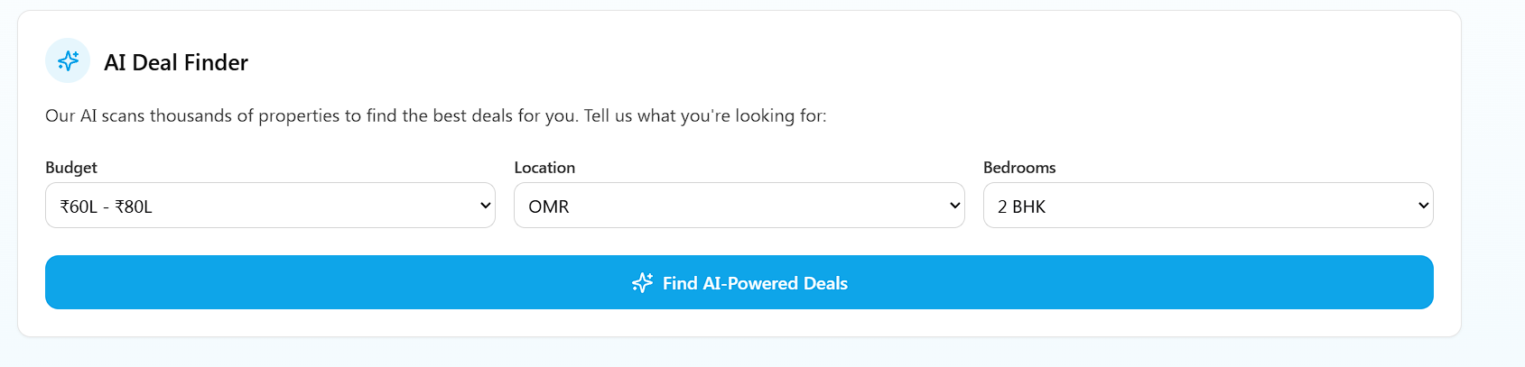
03
An AI Recommendation Chatbot in real estate serves as a virtual assistant, helping property buyers find their ideal homes based on personalized preferences. Unlike traditional search methods, which require buyers to manually filter listings, an AI-powered chatbot interacts conversationally, understanding user needs such as budget, preferred location, amenities, and developer preferences.

Slide 9
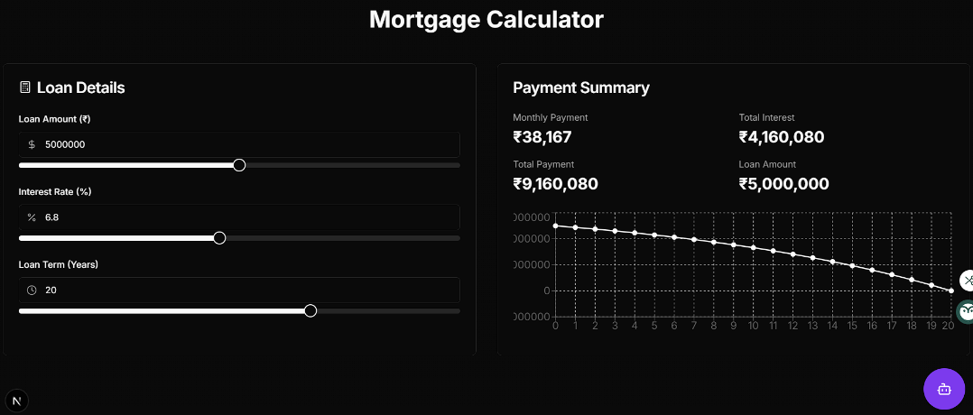
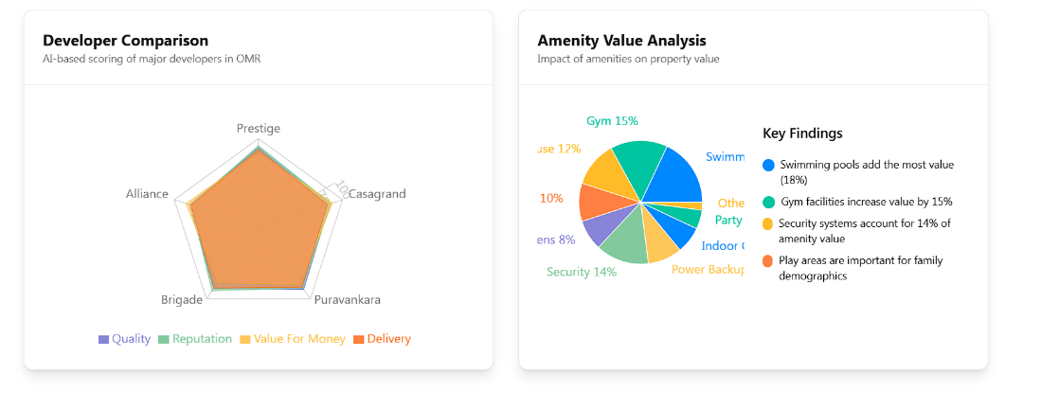
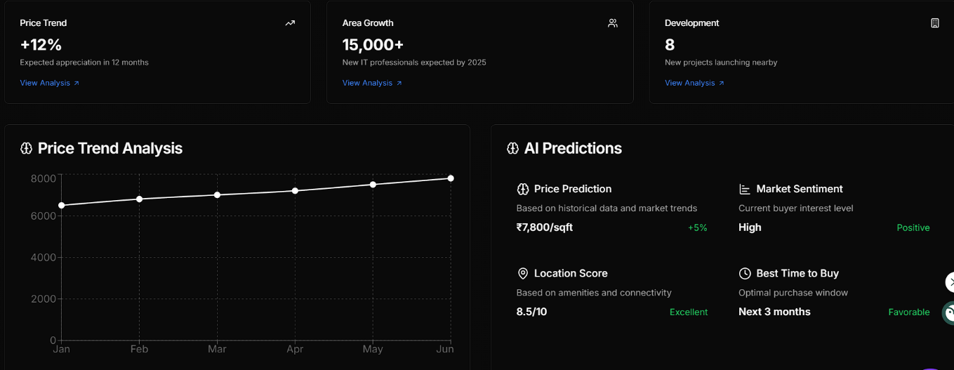
04
Graph Representation

Slide 10
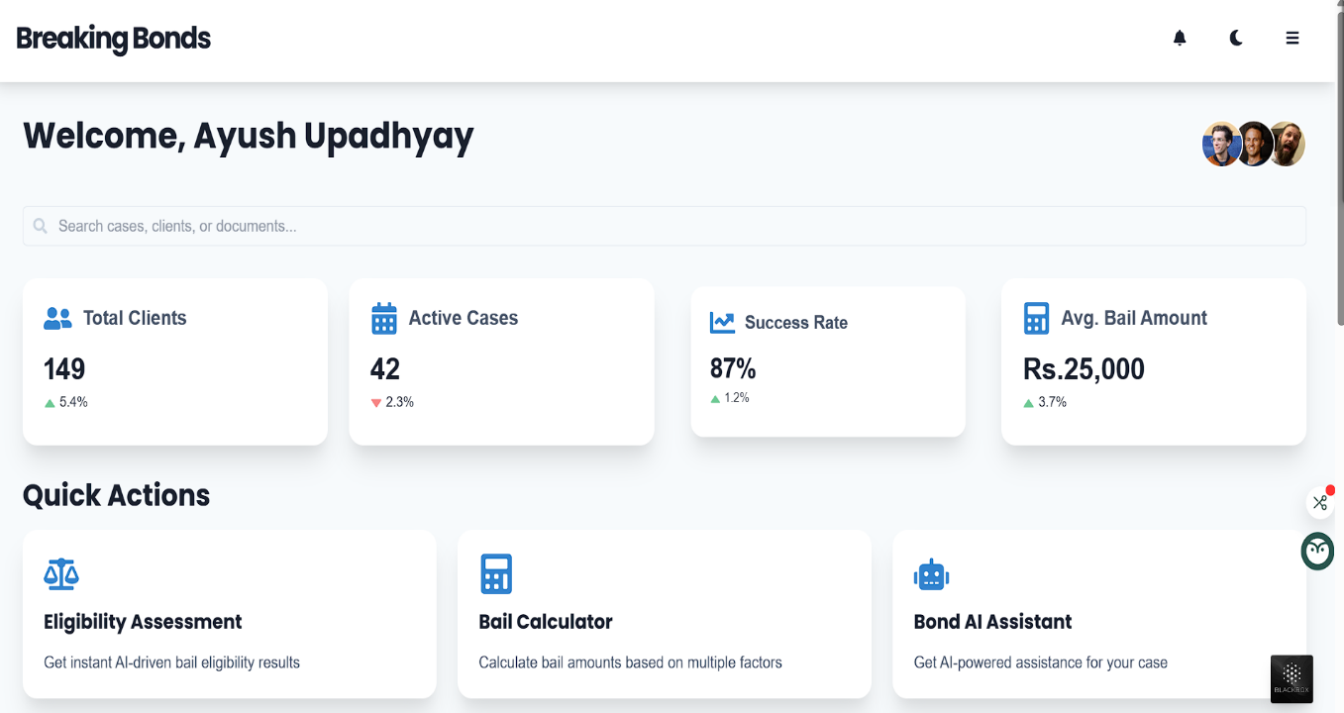
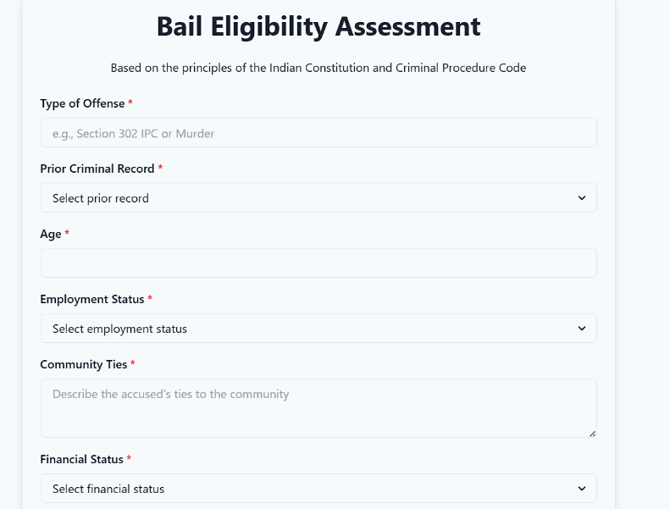
05

Slide 11

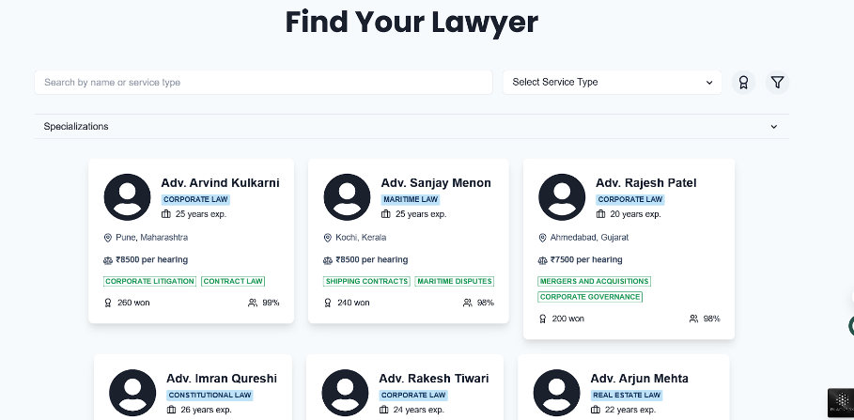
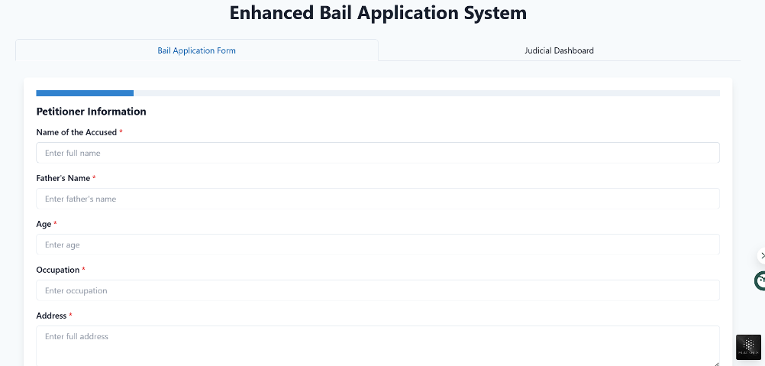
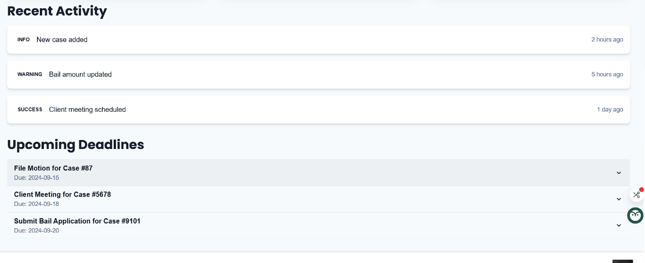
05

Slide 12
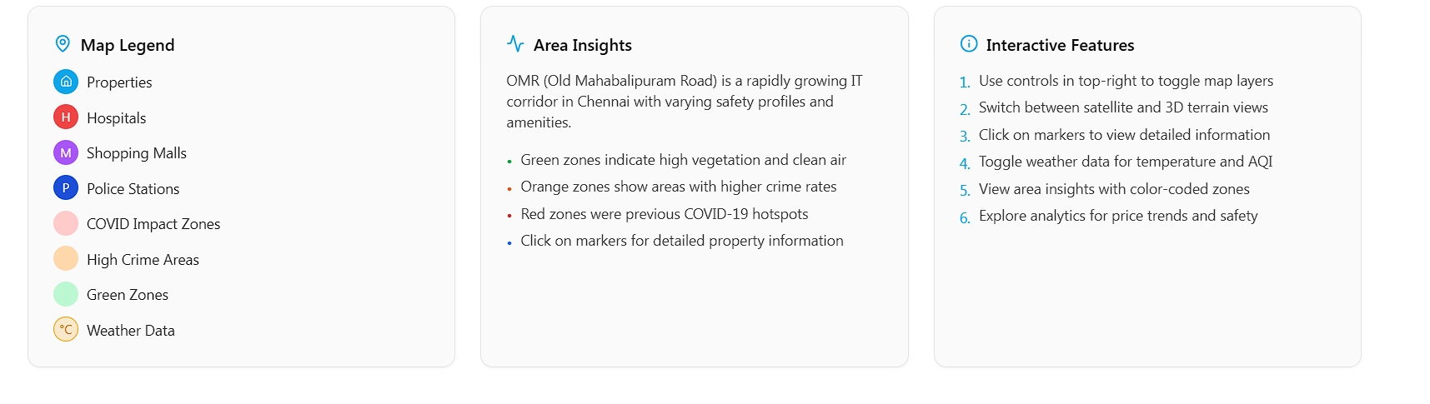
06

Slide 13
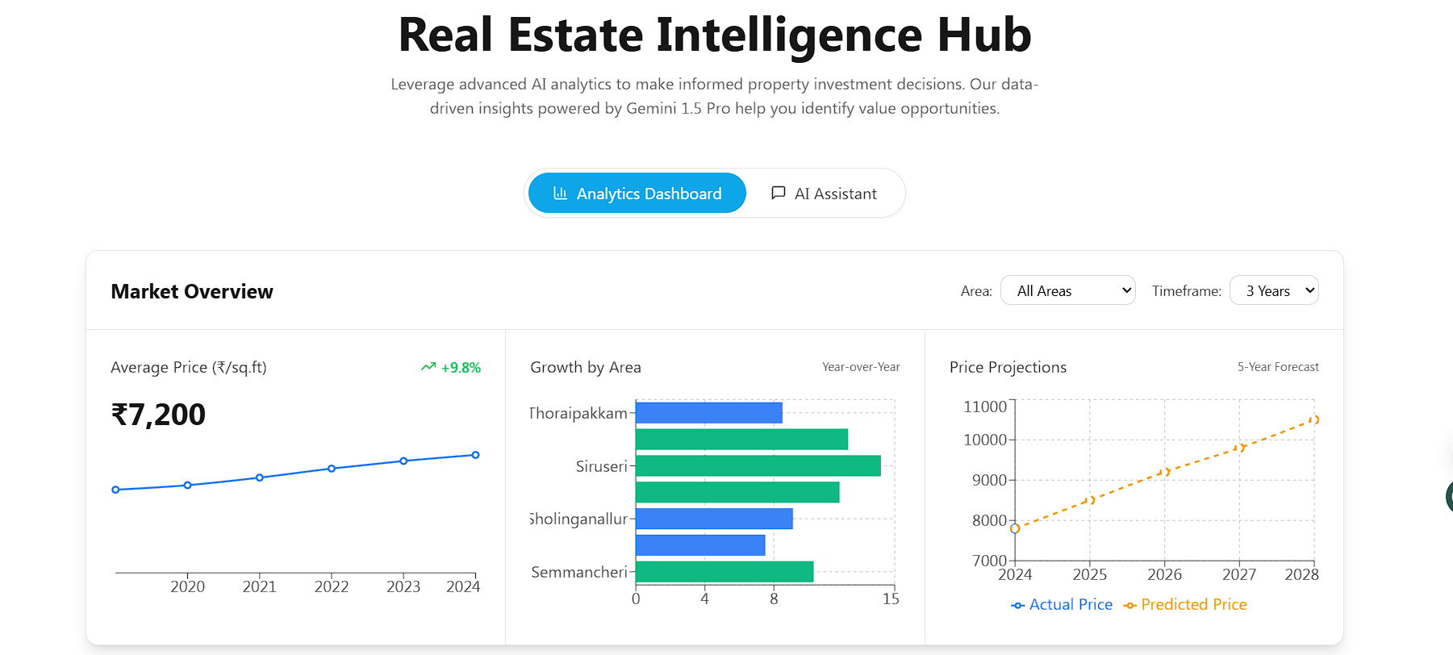
07

Slide 14
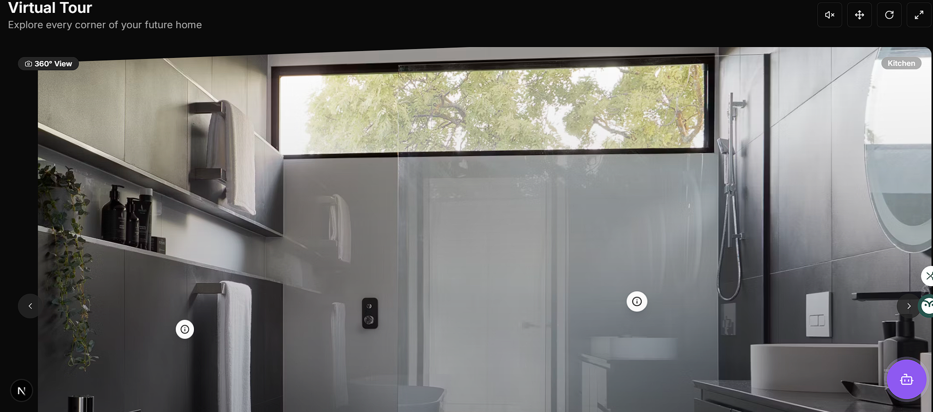
08

Slide 15
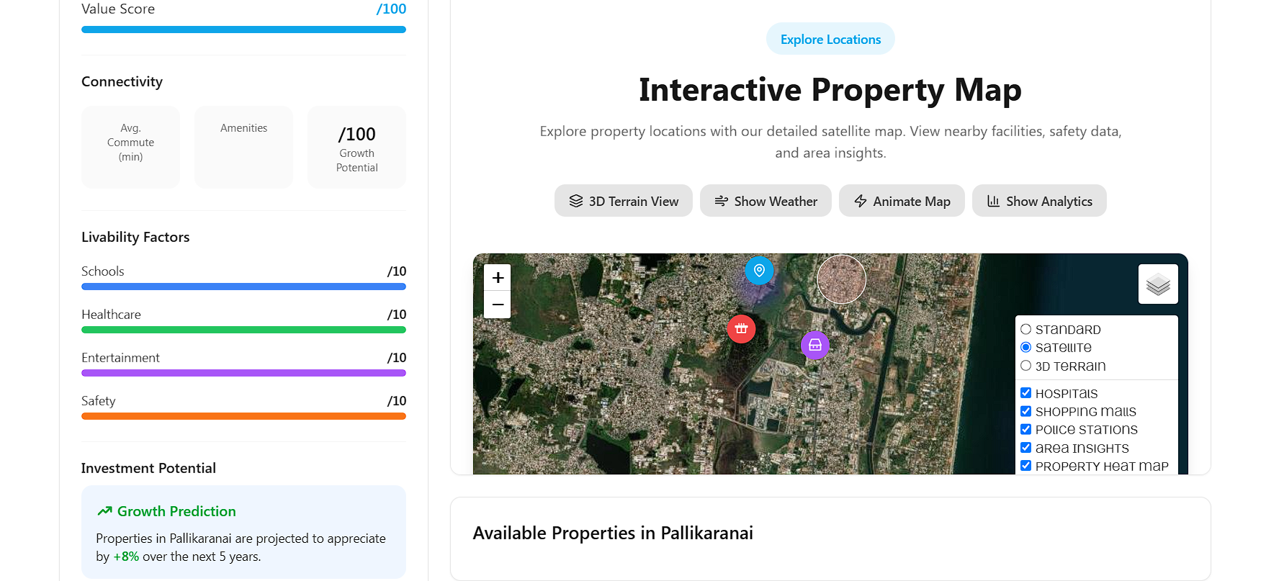
09

Slide 16
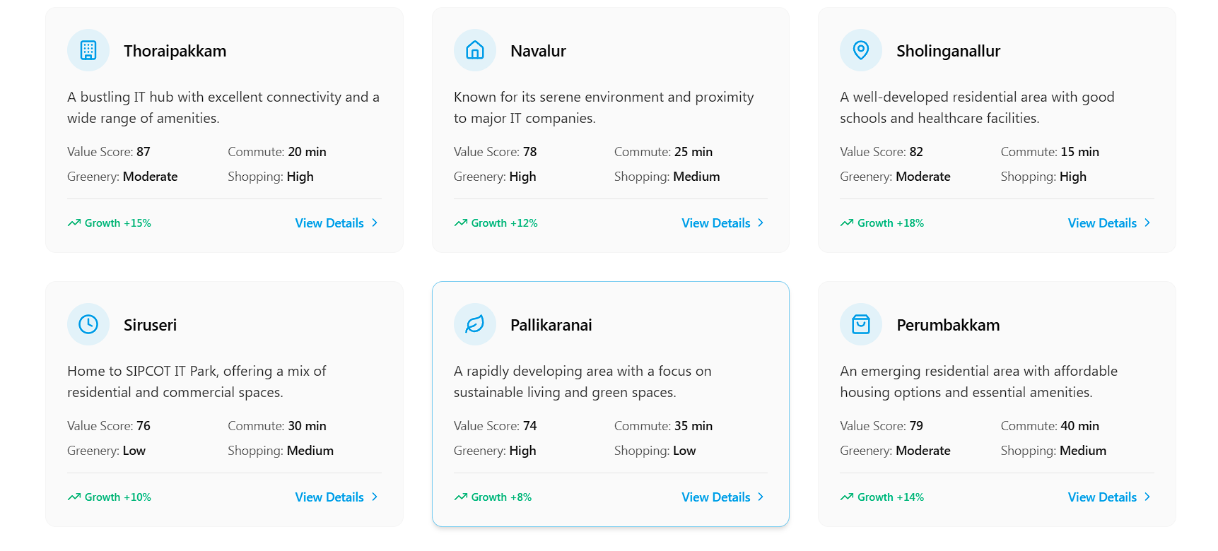
10

Slide 17

Our Future Prospects
A negotiation assistant can suggest the best time to buy based on price fluctuations and developer offers.
Augmented Reality (AR) integration can allow buyers to take immersive virtual property tours directly from their devices, eliminating the need for physical visits.
AI-driven market analysis can predict future property values based on historical trends, helping buyers make investment decisions.

Slide 18

Conclusions
The integration of AI in real estate search processes provides a streamlined and intelligent approach for buyers. By utilizing web crawling and smart comparison techniques, potential homeowners can find properties that not only fit their financial parameters but also suit their personal preferences effectively.

Slide 19
THANK YOU
By: Mohammad Afzal Khan
Ananya Vinay
Ayush Upadhyay
Anok Anil Thomas
Aditya Vasudev K

